Slide 1
Roslyn Public Schools Welcome Entrance Road Residents
Board of Education President
Meryl Waxman Ben-Levy
Superintendent of Schools
Allison Brown
Asst. to the Supt. for Admin. & Special. Projects
Thomas Szajkowski
January 6, 2021

Slide 2
1
11
17
25
33
39
47
55
63
69
77
85
93

Slide 3
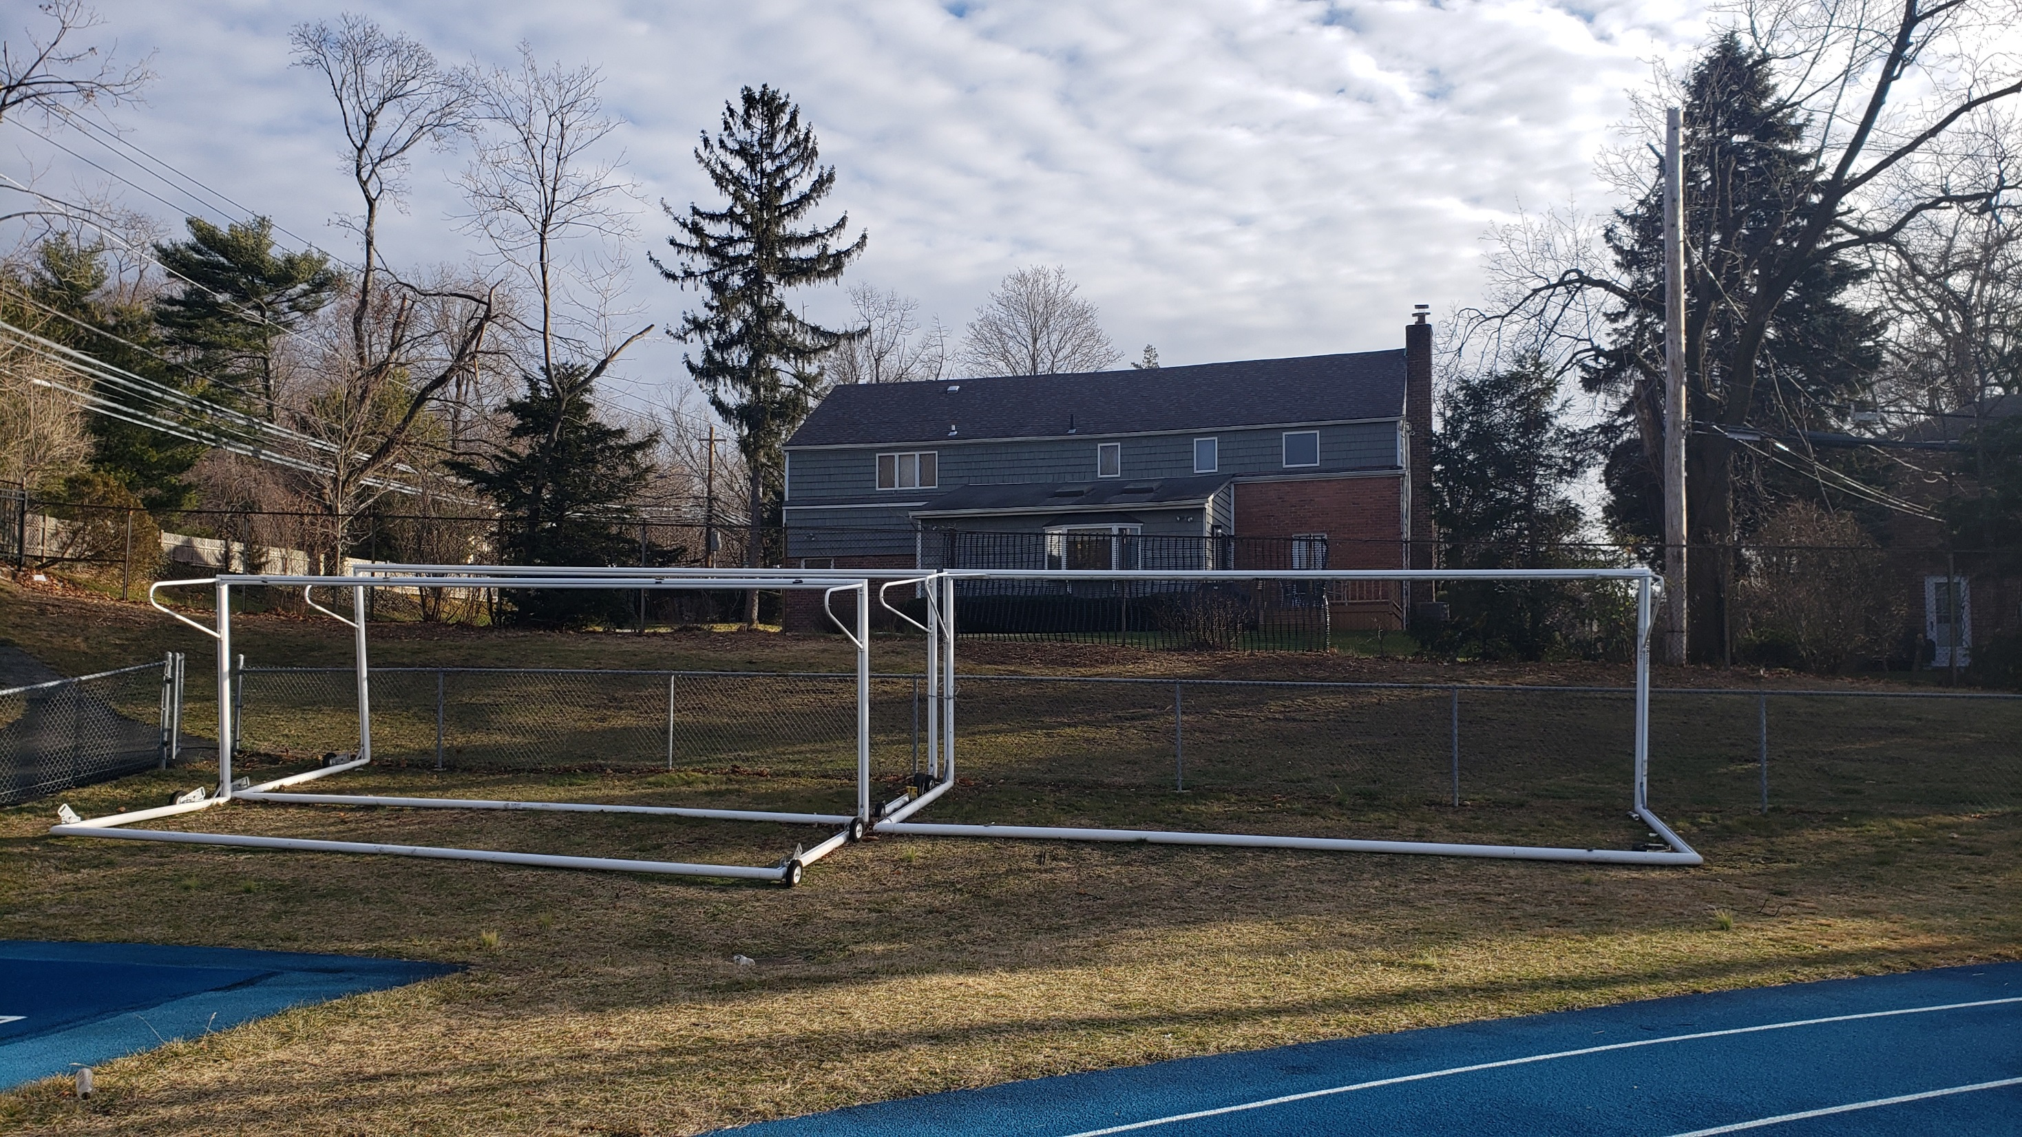
1 Entrance Road

Slide 4
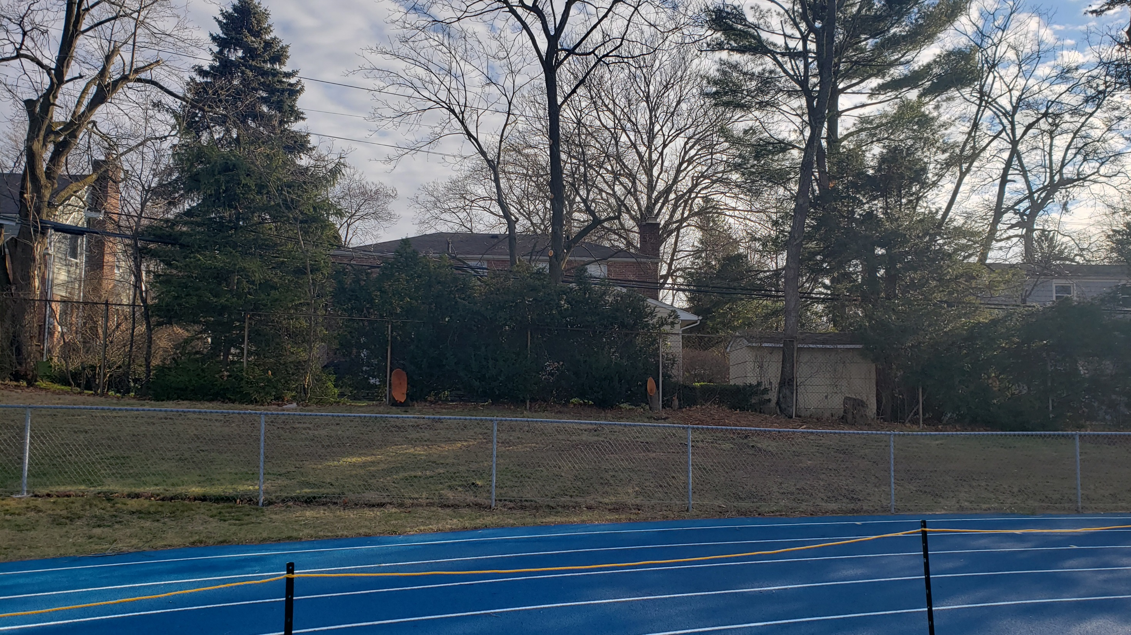
11 Entrance Road

Slide 5
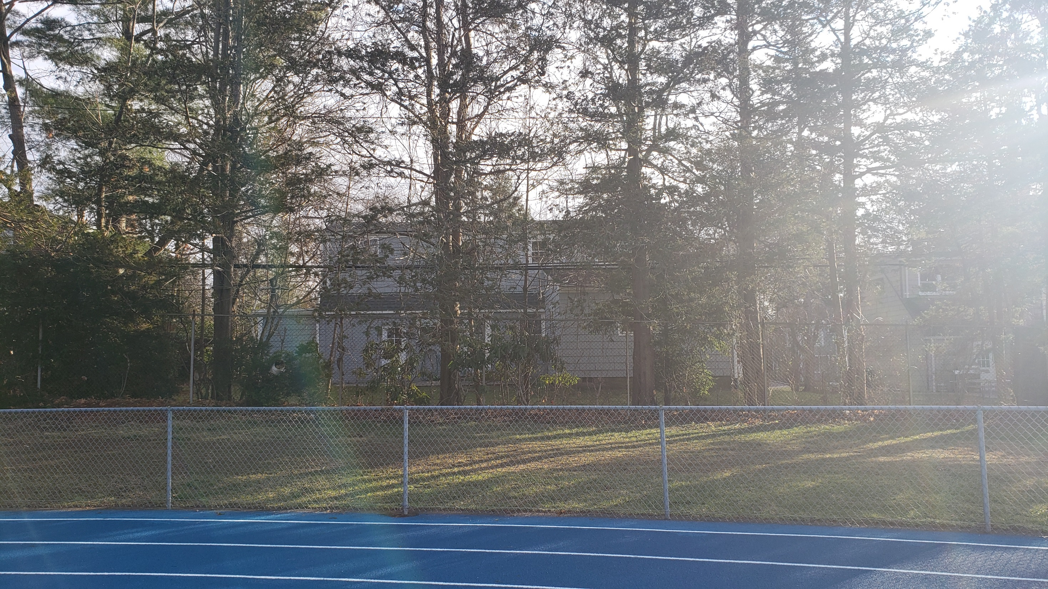
17 Entrance Road

Slide 6
17 Entrance Road

Slide 7
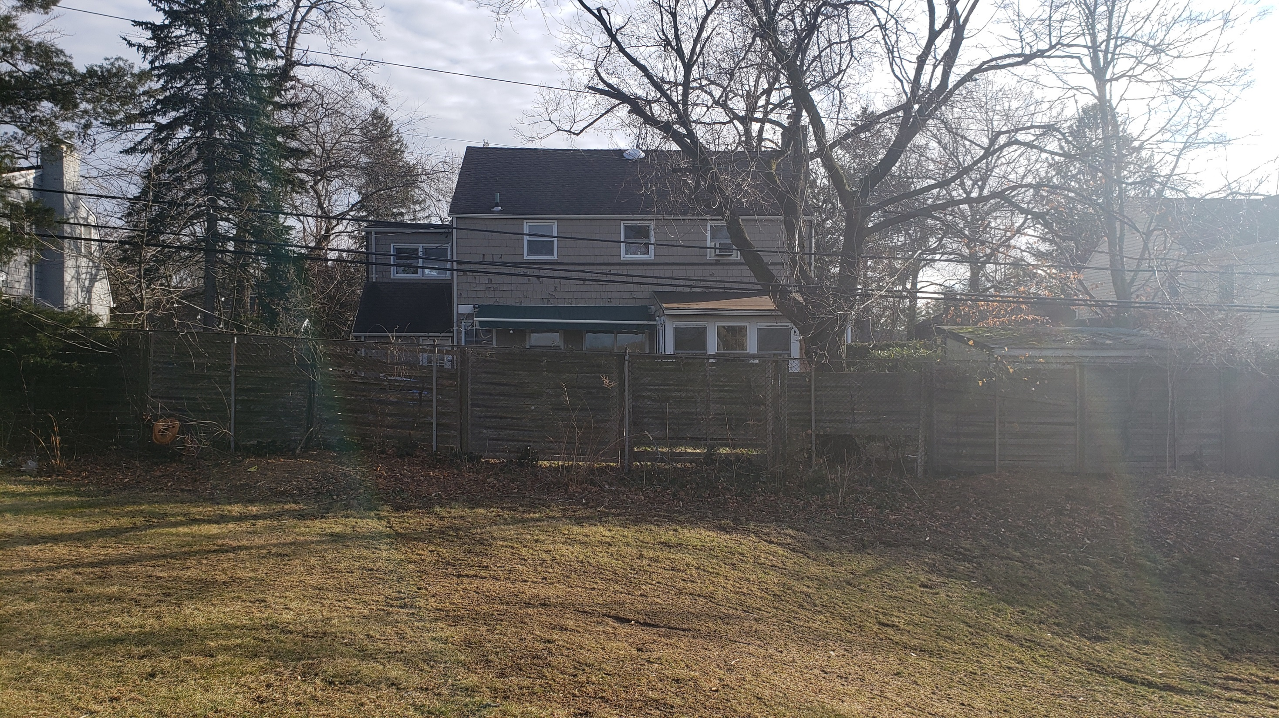
25 Entrance Road

Slide 8
25 Entrance Road

Slide 9
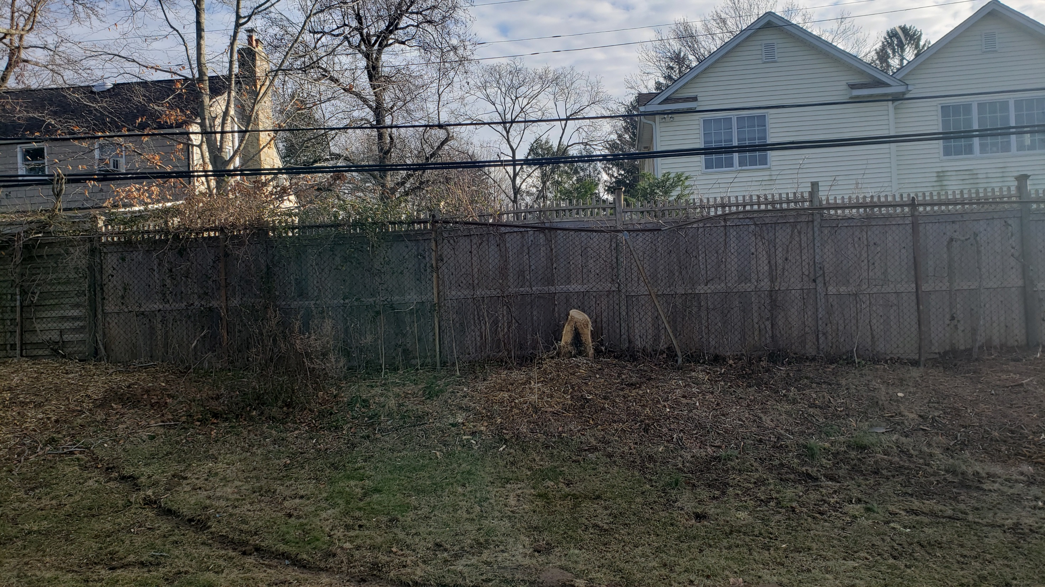
33 Entrance Road

Slide 10
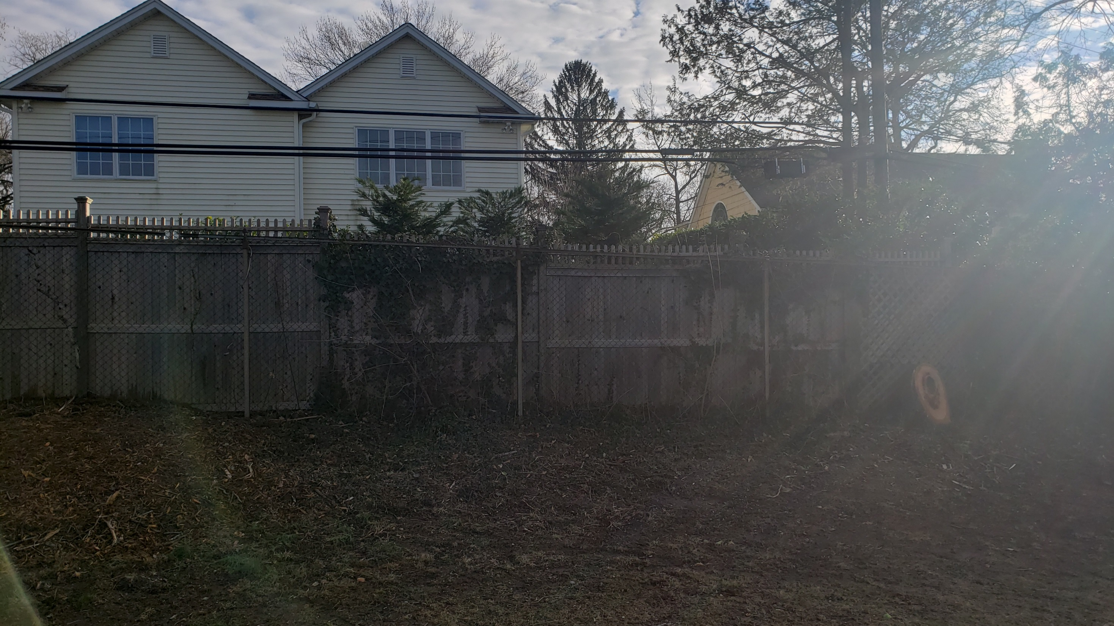
33 Entrance Road

Slide 11
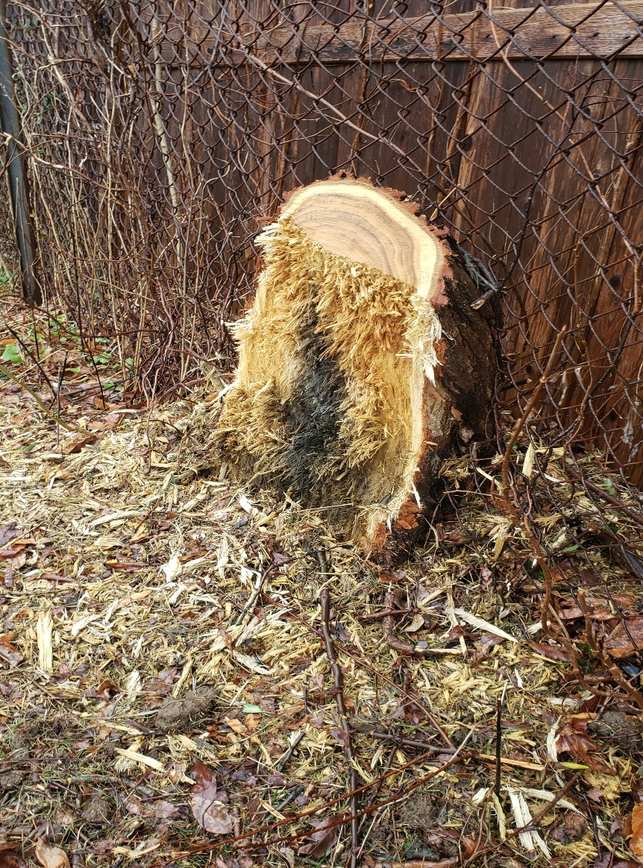
33 Entrance Road

Slide 12
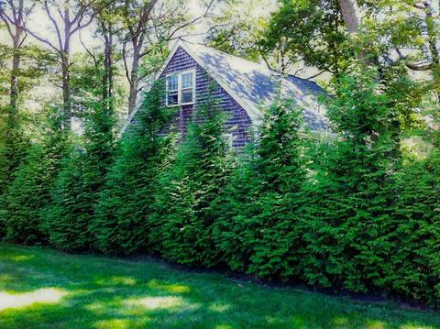
Thuja Arborvite

Slide 13
Thuja Arborvite

Slide 14
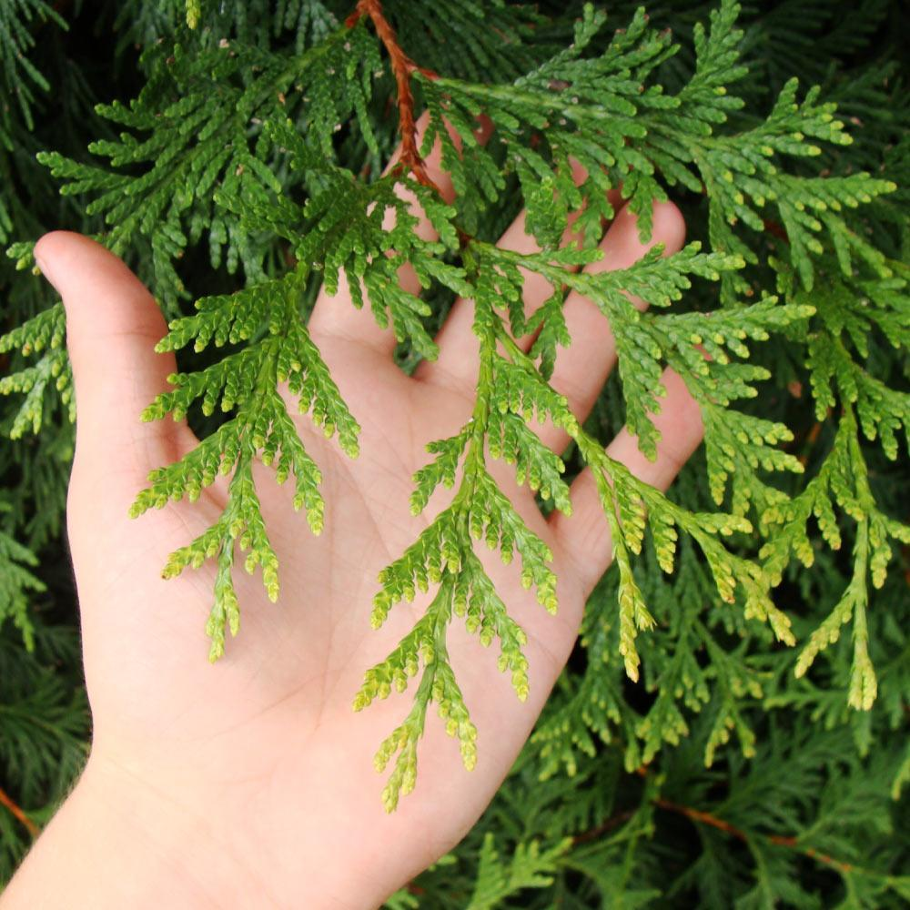
Thuja Arborvite

Slide 15
Questions?

Slide 16
