Slide 1
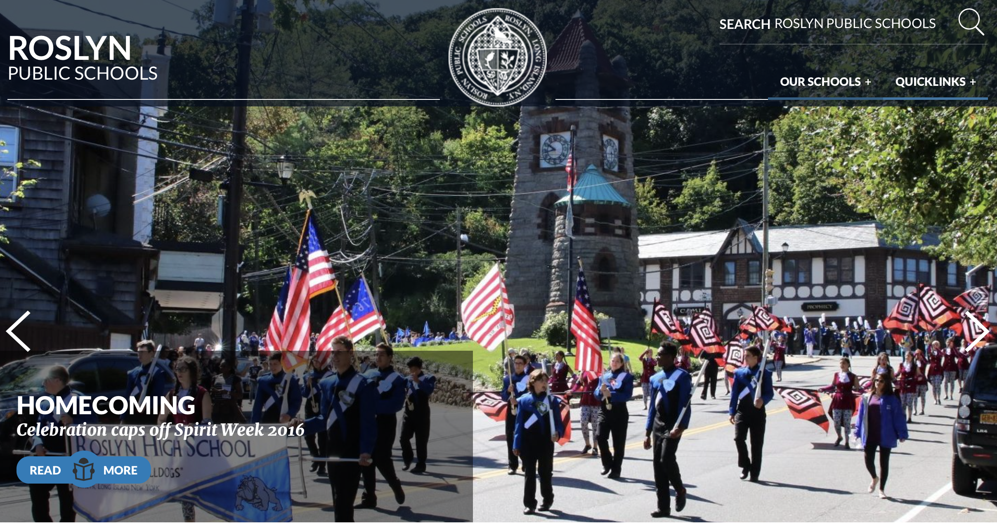
Roslyn Technology
Big Data

Slide 2
The cost of free - Security/Privacy Dilemma
Actions taken today online stay forever
Job hunters look at Facebook and other social networking sites during their hiring process
Not everything needs to be posted online
Selfies, videos, etc… should be appropriate at all times
Internet runs on Google Analytics
Big companies pay big money for data
Notice the advertisements in Facebook or on some webpages are oddly similar to your surfing habits?

Slide 3
Ethics
Devices should be put away at dinner time and other social events
Learn to control yourself and be mindful of your surroundings
Texting while someone is talking to you is rude
Texting, emails, etc.. should not be responded to immediately

Slide 4
Asymmetric and Public Keys
Sites secure data transmission with a public certificates
Only the server with the private key can decrypt the data
The Sender/Client can only encrypt the data

Slide 5
Data Innovations
XML - Tag based mark up language, abstract design
Json (JavaScript Object Notation) is a lightweight data-interchange format
Allows for easily exchanging data with heterogeneous devices such as IBM AS400 servers, iOS, android ,etc…
Both support Serialization (From Strings to Object and back) deserialization.
<User>
<FirstName>
<LastName>
<UserName>
</User>
https://elstestserver.endicia.com/LabelService/EwsLabelService.asmx

